Slide 1
Data Backup Inventory Management System

Slide 2
Table Of Contents
Overview
Benefits
Modules :
User Panel
Admin Panel

Slide 3
Overview
File system backup can be defined as the collection of files and the file management structures on physical or logical storage.
Backups are initiated from the servers.
The User Panel helps the user to add the details of the backup tapes.
The Admin Panel . . .
We can have different types of backups of the systems i.e. daily backups, weekly backups, monthly backups and yearly backups.

Slide 4
Benefits
Higher Reliability – The biggest benefit of regular data backup is its great reliability. Backup can be automated and updated on a daily basis, weekly basis and monthly basis.
Greater Security – When you employ data backup, you store your data in a secure location, making it physically safe.
Ease of Recovery – Due to multiple levels of redundancy, if data is lost or deleted, most likely through individual user error or deletion, backups are available.
Easily Traceability – The user can keep the track of the backup tapes which are send back to the different locations.

Slide 5
Accountability – The admin keeps the track of the changes or the modifications done under the add backup and send backup.
Easy Searchable – The user can easily search for a backup tape by providing various details like date, month, year, category, location etc.

Slide 6
User Panel
The user have various privileges where he can perform different functions such as :
Check Available Backup Summary.
Check Send/Receive Backup Summary.
Check Daily/Yearly Backup Summary.
Add Backup.
Send Backup.

Slide 7
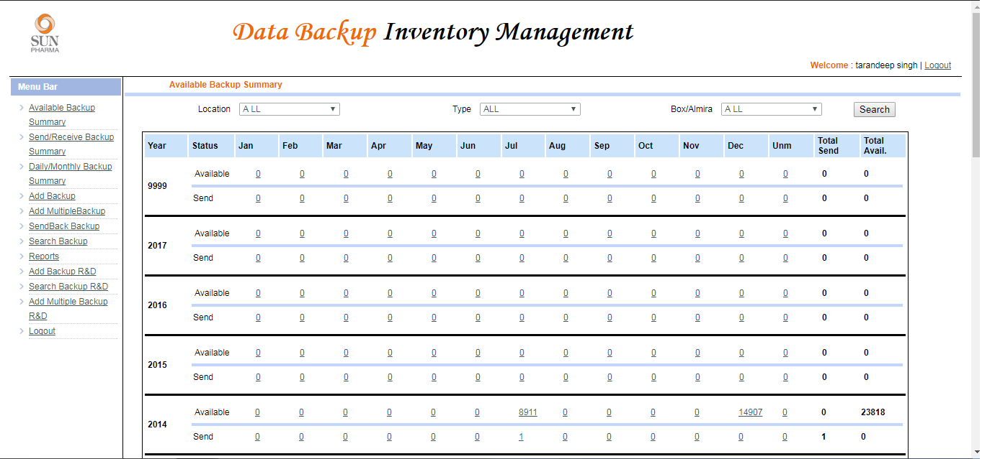
Available Backup Summary
The below picture shows us the summary of the available backups tapes in a location.

Slide 8
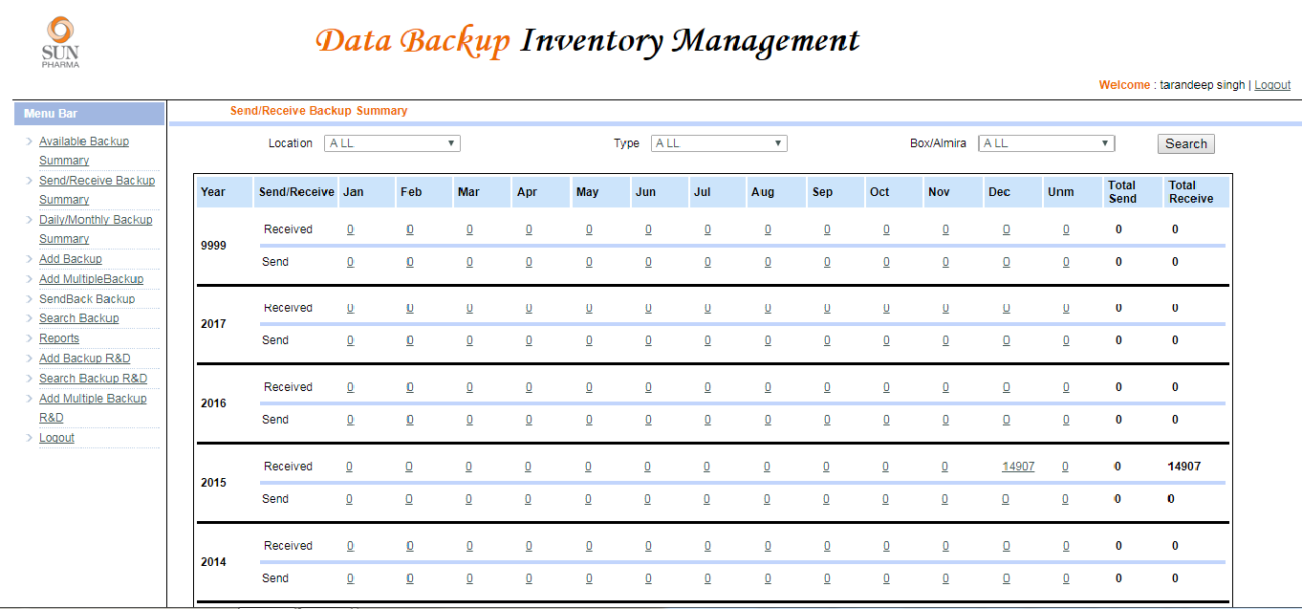
Send/Receive Backup Summary
The below picture shows the Tapes we have received yearly and the tapes we have sent back.

Slide 9
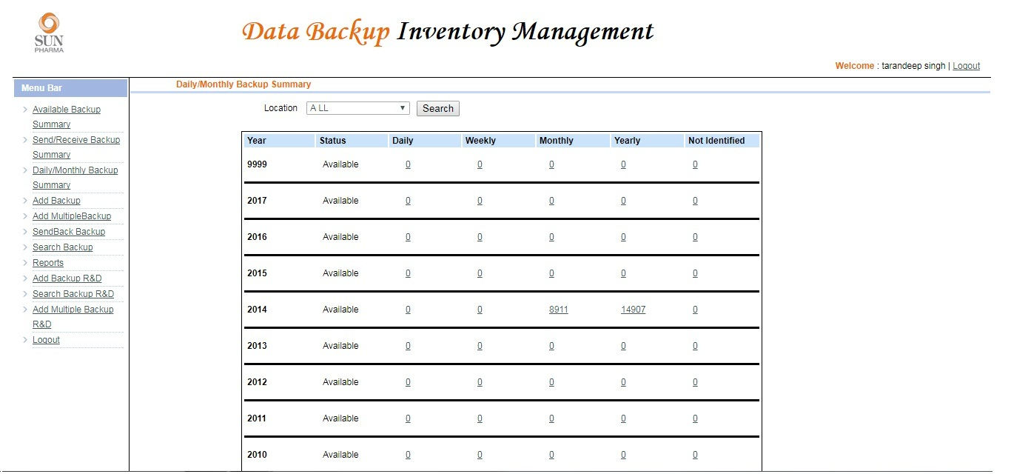
Daily/Monthly Backup Summary
The below picture shows the availability of backup tapes at a particular location, arranging them in daily, weekly, monthly and yearly.

Slide 10
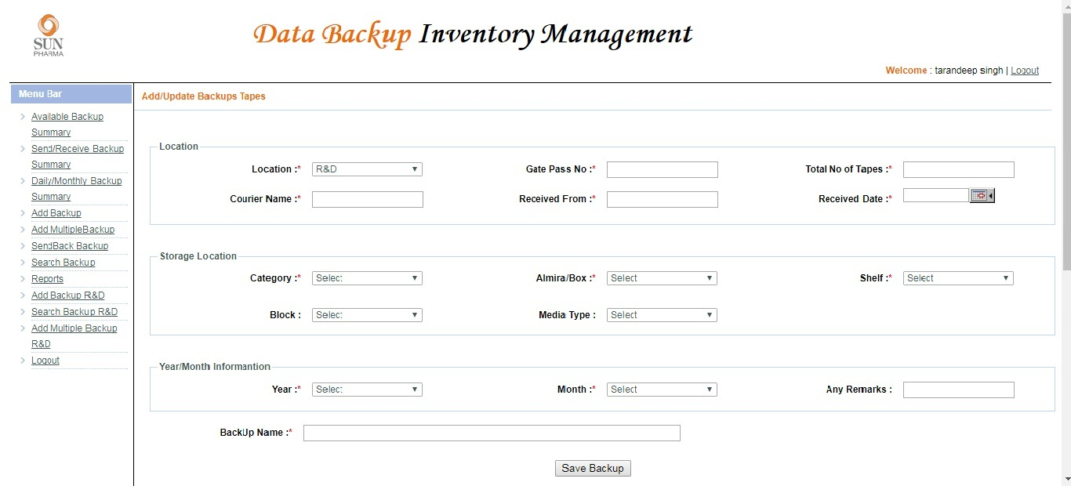
Add Backup
The add backup is used to add a record in the system. It has various fields which are filled by the user at the time of entering a new backup tape.

Slide 11
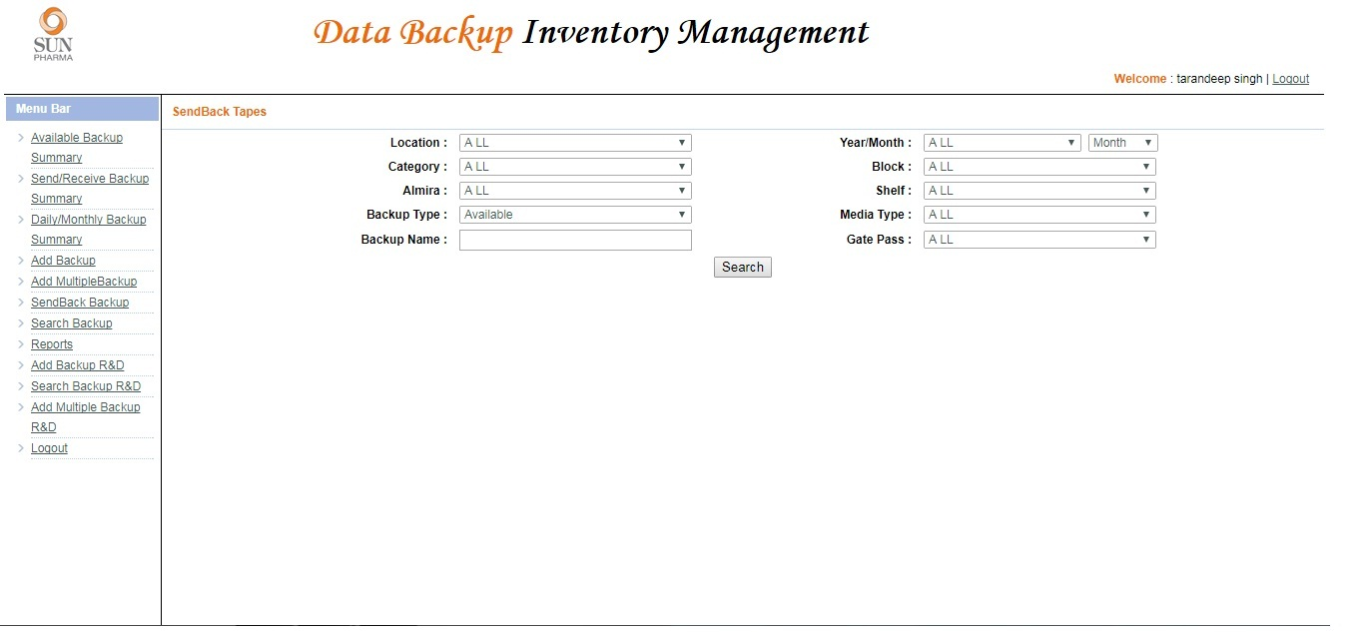
Send Backup
The user can send back the backup tapes to the location where it is necessary.

Slide 12
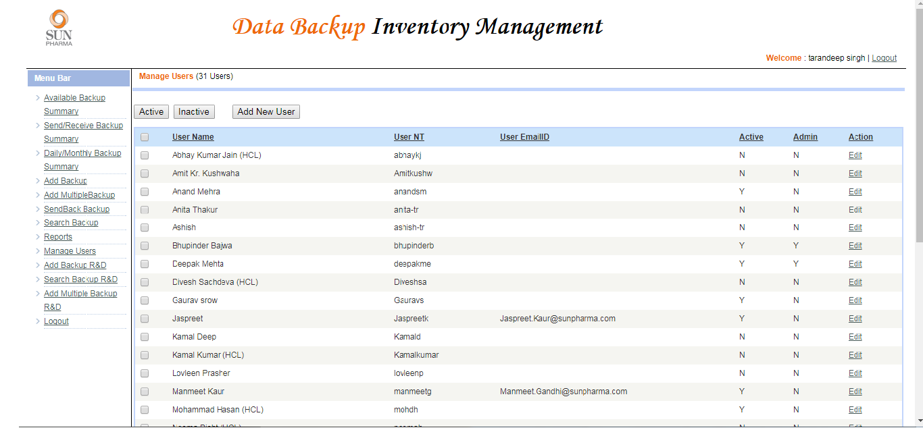
Admin Panel
The admin can Grand and Revoke privileges from the users and can add new users.

